Slide 2
DNS across a multi-account environment
SEC347-R
Paul Bayer
Senior Consultant, Cloud Infrastructure Architecture
Amazon Web Services

Slide 3
Agenda
Problem statement
Current solutions
Design Points to Consider
Previous solutions
Best Practices

Slide 4
Related breakouts
[Session ID] [Session Title]
[Session ID] [Session Title]
[Session ID] [Session Title]
[Session ID] [Session Title]
[Session ID] [Session Title]
[Session ID] [Session Title]

Slide 5
Let’s talk
Join us in the [track name] Networking Lounge at [location] on [day], December [date], from [start time] to [end time].

Slide 6
Problem statement

Slide 7
Problems to {re}solve
How to prevent data exfiltration
https://dejandayoff.com/using-dns-to-break-out-of-isolated-networks-in-a-aws-cloud-environment/
How to consistently resolve names when servers aren’t using the same DNS servers?
What name should I use to refer to a given machine?
Where should machines register their hostname?
To their Active Directory on-prem?
To their cloud-native private zone?
Do we really need to register names at all?

Slide 8
DNS Overview
DNS (Domain Name Service)
Critical fundamental service to all IP communications
Resolves name to IP (forward)
Resolves IP to name (reverse)
Easy to unknowingly get wrong
Critical for use with TLS/certificates
DO NOT USE HOSTS FILES

Slide 9
DNS zones/namespaces we’ll discuss
VPC native
“compute-1.amazonaws.com” (Amazon EMR)
“compute.internal” / “ec2.internal” (Amazon EC2)
Custom-named zones
“cloud.example.com”
Must manually add names to the hosted zone*
On-premises zones
“on-prem.example.com”
Can be automatically registered to Active Directory’s DNS
*Yes, you can write a lambda to do this

Slide 10
Private Hosted Zone
Private Hosted Zone – abbreviated “PHZ”
Owned by a single Account – but shared / associated with 1 or more VPCs.
See code snippet for how to associate
There is no charge to associate this PHZ with multiple VPCs
PHZ is a global service, so you may need to create multiple phzs and shared them with appropriate VPCs as necessary.

Slide 11
DNS Enhancements
EDNS(0)
Wikipedia: https://en.wikipedia.org/wiki/Extension_mechanisms_for_DNS
Enables DNS to support larger than 512 byte packets within UDP
Opens up additional capacity for flags and features
DNSSEC
Wikipedia: https://en.wikipedia.org/wiki/Domain_Name_System_Security_Extensions
Method to ensure a chain of integrity starting with the DNS root
Requires every zone to SIGN their records, and update the signatures periodically
If the chain is broken – resolution will not work
If DNSSEC isn’t supported at the root, then it won’t be requested further down

Slide 12
Current Solution

Slide 13
{Re}solution (Question 1)
How to prevent DNS queries from exfiltrating data?
Allow connections to only KNOWN endpoints
Don’t let them even REQUEST unknown websites
Log all data sent via DNS queries (already done on-prem)

Slide 14
{Re}solution (Question 2)
How to consistently resolve names when servers aren’t using the same DNS servers?
There should always be only one source of truth for DNS. There may be many roads to that source, but only one authority.
Split DNS works for some situations, but does require additional care.

Slide 15
{Re}solution (Question 3)
What name should I use to refer to a given machine?
Let’s use something that won’t change just because you scaled, updated, released, etc.
Let’s talk about which machines you’re going to name…
Good things to name:
Load Balancers
EMR Master servers
Individual machines (Fault Tolerance?)
On-prem resources should resolve *on-prem*
Cloud resources should resolve *in the cloud*

Slide 16
{Re}solution (Question 4)
Where should machines register their hostname?
To the Active Directory on-prem?
If you’re going to use AD authentication, you may need to do that
To their cloud-native private zone?
Can be done on instance-creation with Lambda functions
Do we really need to register names at all?
“Cattle, not pets” – consider the ephemerality of your instances
Registering your host to AD doesn’t mean you must use that server as your primary DNS, only that the AD domain is always resolveable.

Slide 17
Demo of Use Cases

Slide 18
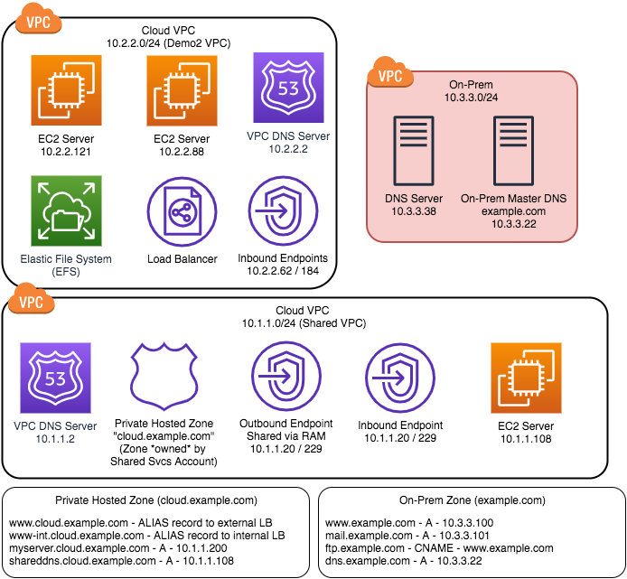
Overall Environment
Source VPC
App VPC
Shared Services
Central VPC
On-Prem
On-Premises replica
Private Hosted Zone
On-Prem Zone
EFS Mount
Load-Balancer URL

Slide 19
Use Cases
Cloud resource to resolve a local AWS-native name
Cloud resource to resolve a PHZ name
On-Prem resource to resolve an AWS-native name (EFS)
Cloud resource to resolve an on-prem name
Cloud resource to resolve ANYTHING else

Slide 20
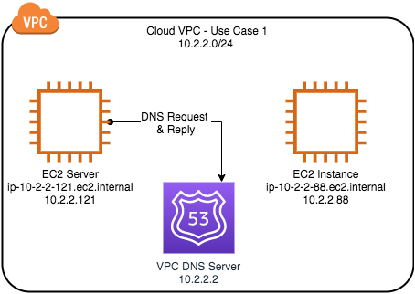
Diagram - Use Case 1 (Cloud resource to resolve a local AWS-native name)
Query from “121”
dig ip-10-2-2-86.ec2.internal

Slide 21
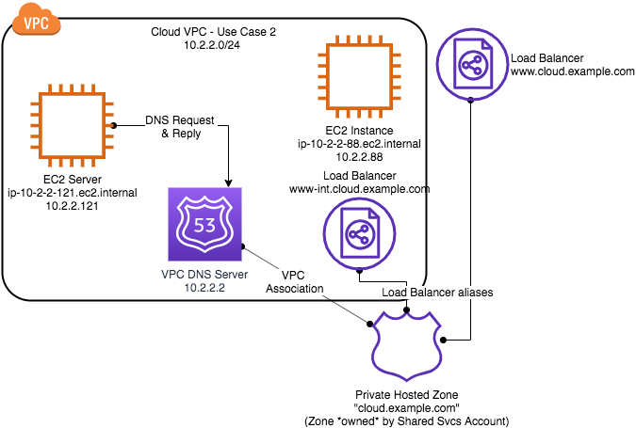
Diagram - Use Case 2 (Cloud resource to resolve a PHZ name)
Query from “121”
dig www.cloud.example.com
dig www-int.cloud.example.com

Slide 22
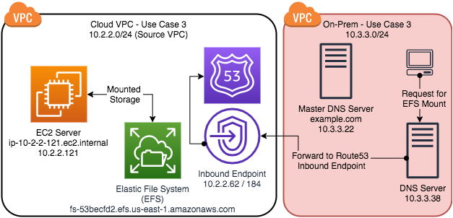
Diagram - Use Case 3 (On-Prem resource to resolve an AWS-native name (EFS))
Query from “on-prem”
dig fs-53bec…

Slide 23
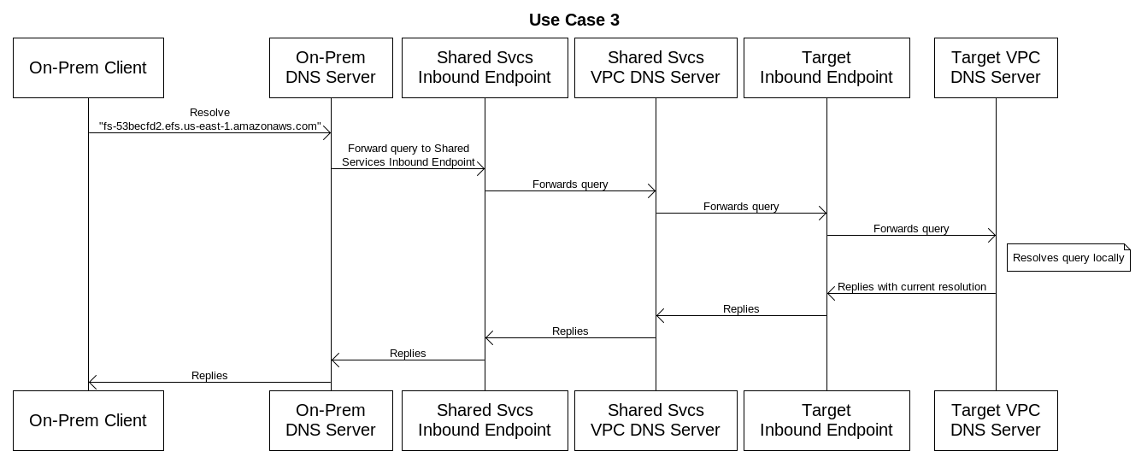
Diagram - Use Case 3 (Cloud resource to resolve an AWS-native name in another VPC (EKS))

Slide 24
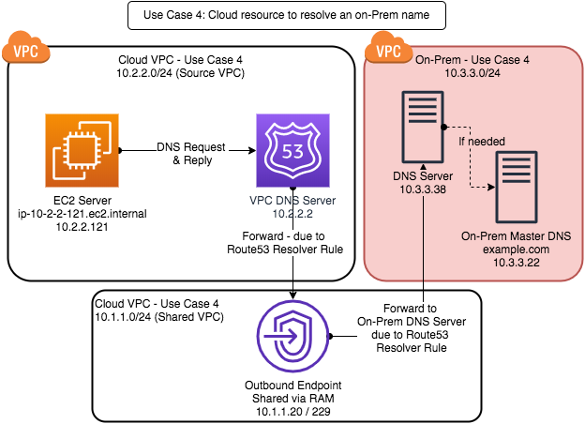
Diagram - Use Case 4 (Cloud resource to resolve an on-prem name)
Query from cloud
dig www.example.com

Slide 25
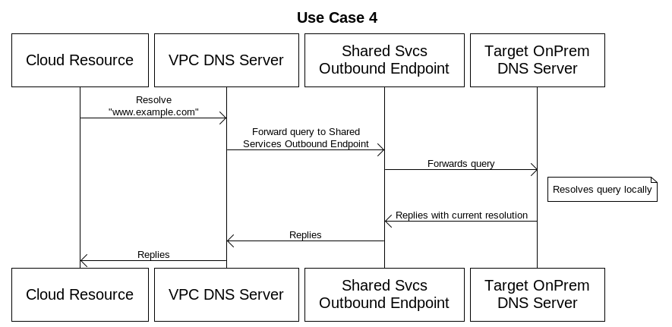
Diagram - Use Case 4 (Cloud resource to resolve an on-prem name)

Slide 26
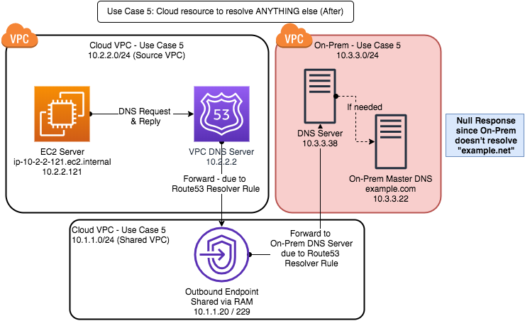
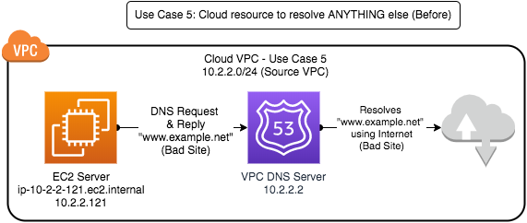
Diagram - Use Case 5 (Cloud resource to resolve ANYTHING else)

Slide 27
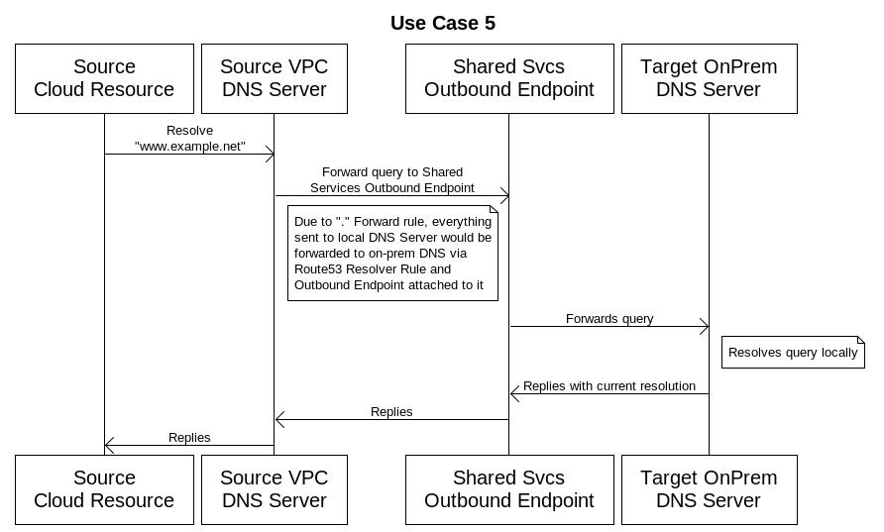
Diagram - Use Case 5 (Cloud resource to resolve an on-prem name)

Slide 28
Use Case Name | Requester | Target | Using AmazonProvidedDNS (VPC DHCP options point to VPC’s “.2” DNS server) | New Route53 resolver feature (Route53 rules to point to on-prem DNS for on-prem resolution) | Using on-prem Active Directory DNS only (VPC DHCP options point to on-prem AD DNS server) | Using Active Directory DNS on EC2 instances in SharedSvcs VPC replicated with on-prem | Using DNS Proxies in each VPC (VPC DHCP options point to proxy DNS server. Proxy forwards queries as needed)
Auto-Scaling Web Server | Standalone EC2 instance | Peer EC2 instance (ip-w-x-y-z.ec2.internal) | Success | Success | If the EC2 instance has NOT joined the AD domain, then it will NOT be allowed to dynamically register to the DNS server, and its name and IP will not be registered, therefore querying the AD DNS server will fail. | If the EC2 instance has NOT joined the AD domain, then it will NOT be allowed to dynamically register to the DNS server, and its name and IP will not be registered, therefore querying the AD DNS server will fail. | Since the proxy will forward this query to the VPC DNS server – the query will succeed.
Auto-Scaling Web Server (using custom domains) | Standalone EC2 instance | Peer EC2 instance’s custom VPC domain name (hostname.cloud.example.com) | Create the hosted zone within Route 53. Enable dynamic updating of the Route53 zone via Lambda events (here) | Create the hosted zone within Route 53. | If the EC2 instance has NOT joined the AD domain, then it will NOT be allowed to dynamically register to the DNS server, and its name and IP will not be registered, therefore querying the AD DNS server will fail. | If the EC2 instance has NOT joined the AD domain, then it will NOT be allowed to dynamically register to the DNS server, and its name and IP will not be registered, therefore querying the AD DNS server will fail. | Since the proxy will forward this query to the VPC DNS server – the query will succeed.
AD Joined EC2 Server (using custom domains) | AD joined EC2 instance | Peer EC2 instance’s custom VPC domain name (hostname.cloud.example.com) | Since the requesting EC2 instance is joined to the domain, it can’t use AmazonProvidedDNS as its primary DNS server. This scenario would fail. | Create the Route53 Resolver rules within Route 53 to point to the on-prem AD DNS servers. | This will fail since the on-prem DNS server will not know which VPC’s DNS server is authoritative for the specific name (unless it’s within the hostname), and will therefore fail. | This will fail since the on-prem DNS server will not know which VPC’s DNS server is authoritative for the specific name (unless it’s within the hostname), and will therefore fail. | Since the proxy will forward this query to the OnPrem AD or Cloud-based AD DNS server – the query will succeed.
Access to On-Prem resource | Standalone or AD joined EC2 instance | Peer EC2 instance’s Active Directory name (hostname.on-prem.example.com) | If the requesting EC2 instance is joined to the domain – Success! If the requesting EC2 instance is standalone, there’s no way to resolve on-prem hostnames – Failure. | Create the Route53 Resolver rules within Route 53 to point to the on-prem AD DNS servers. | Success | Success | Since the proxy will forward this query to the OnPrem AD or Cloud-based AD DNS server – the query will succeed.
RedShift/ Private Endpoint datastore | Standalone EC2 instance | AWS Managed service or otherwise non-AD joined resource (PrivateLink, EMR child node, Redshift cluster, etc.) | Success | Since you’re using AmazonProvidedDNS, this will succeed without any alteration. | This will fail, since the on-prem DNS server can’t send the query back to the origin VPC’s DNS server. Note: We may see negative success here if the PrivateLink / AWS servicename is publicly available and an Internet path exists | If Lambda is used to update a custom domain zone within Route53 that’s shared with the SharedServices VPC (with the AD DNS server), and the Lambda updates the hosted zone with the right IP address – Success! | Since the proxy will forward this query to the VPC DNS server – the query will succeed.
RedShift/ Private Endpoint datastore | AD joined EC2 instance | AWS Managed service or otherwise non-AD joined resource | Since the EC2 instance is joined to the domain, it can’t use AmazonProvidedDNS as its primary DNS server. This circumstance would fail. | Since you’re using AmazonProvidedDNS, this will succeed without any alteration. | This will fail, since the on-prem DNS server can’t send the query back to the VPC’s DNS from which it came. | This will fail, since the on-prem DNS server can’t send the query back to the VPC’s DNS from which it came. | Since the local VPC proxy will forward this query to the VPC DNS server – the query will succeed.
Final Recommendation |  |  | Use in cases where there is no expectation of on-premises interaction. | Recommended general solution in all cases. | Only use in cases where Cloud is acting as data-center extension and no cloud services will be used.

Slide 29
Previous Solutions

Slide 30
Former solutions
Native VPC DNS
Doesn’t resolve on-premises names
Private hosted zones w/ Lambda to mirror on-prem zones
Complex
Unbound (DNS proxies)
Have to manage additional servers
PPS DNS limits
DNSMasq on every instance
A lot to administer
Point to shared services DNS (AD) & forward to AWS DNS
Doesn’t handle managed service names properly
Reverse resolution can be problematic

Slide 31
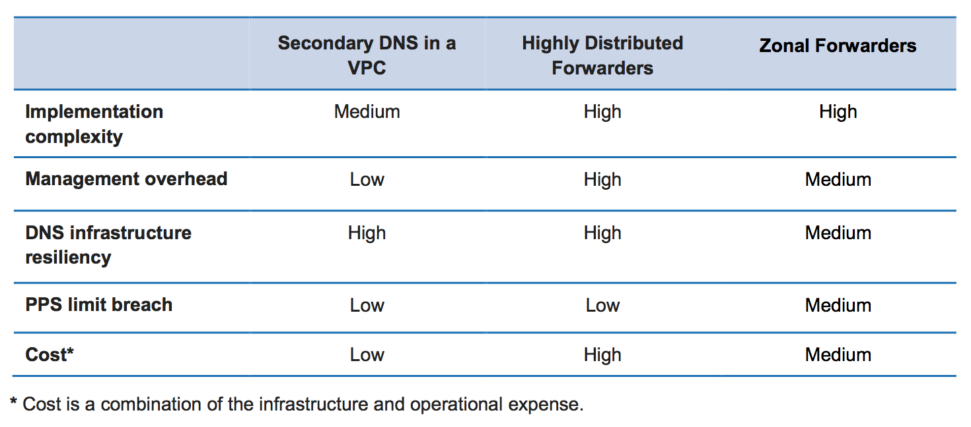
Former Best Practices
From “hybrid-cloud-dns-options-for-vpc.pdf”

Slide 32
Managed Services Considerations
EKS
The names of the cluster are known only within the individual VPC.
API Gateway
The API Gateway service (used in “Private mode”) provides a name for the
EMR
The communication between the master node and the children use both forward and reverse DNS.
Console access to EMR is typically required, so connecting the Master Node to AD is a typical use-case.
Since the children nodes cannot be joined to AD – using the AD DNS (for authentication) without being able to resolve the children nodes (both ways) will prevent the EMR cluster from working properly.
This has been previously solved by using DNSMasq – and it works! – but it’s tough to explain to an Enterprise customer.
Glue
The communication between nodes and Glue uses – by default – reverse DNS to authenticate the caller to the Glue service. This makes no sense, and can be disabled with a ticket to the service team (per account), but it’s still a silly limitation.
EFS
EFS is only properly resolvable from within the VPC you’re using it within. While it’s accessible from elsewhere, only the local VPC DNS server knows the proper name. Therefore – if you want to use the name, you need to resolve the name through the specific, appropriate VPC DNS.

Slide 33
Design Points to Consider

Slide 34
Managed services considerations
Amazon EKS
The names of the cluster are known only within the individual VPC
Amazon API Gateway
The API Gateway service (used in “Private mode”) provides a name for the APIGW via the Internet – although it’s not a “friendly” name.
Amazon EMR
The communication between the master node and the children use both forward and reverse DNS
Console access to Amazon EMR is typically required, so connecting the master node to AD is a typical use case
Since the children nodes cannot be joined to AD, using the AD DNS (for authentication) without being able to resolve the children nodes (both ways) will prevent the Amazon EMR cluster from working properly
This has been previously solved by using DNSMasq—and it works, but Route53 Rules are better
AWS Glue
The communication between nodes and AWS Glue has used—by default—reverse DNS to authenticate the caller to the AWS Glue service.
Amazon EFS
Amazon EFS is only properly resolvable from within the VPC you’re using it within. While it’s accessible from elsewhere, only the local VPC DNS server knows the proper name. Therefore, if you want to use the name, you need to resolve the name through the specific, appropriate VPC DNS.

Slide 35
VPC endpoints and DNS
VPC endpoints (interface) work by creating “hidden” DNS names that redirect via IP
This resolution is ONLY available within the specific VPC that you’ve created the endpoint*
Therefore, the proper resolution is critical to ensure you’re using the private endpoints and not an internet gateway
If you create a PHZ for the endpoint names – you can share endpoints across VPCs, and drastically reduce your costs on endpoints.
Automate the association of new VPCs with the PHZ in that region

Slide 36
Order of DNS resolution
Order of resolution for each DNS query that arrives at the +2 AWSProvidedDNS endpoint:
Is there a Route 53 Resolver rule that applies?
Pick most specific applicable rule
This includes a few hidden rules/ zones (URL needed)
Is there a Private Hosted Zone that applies?
Pick the most specific applicable zone
Resolve within AmazonProvidedDNS

Slide 37
Forwarding vs. Delegation
Wouldn’t it be nice if we could delegate zone authority to the inbound resolvers or a DNS server within the cloud that then did a recursive lookup (forward) for us?
YES – that would be awesome.
But, it’s anti-thetical to how DNS works
If we delegate – it’s because the server we’re delegating to is AUTHORITATIVE for that zone.
If it was authoritative, it doesn’t need to forward.
If we forward – we know it’s going to ask someone else, therefore, we ask a recursive question.
Therefore – we can’t delegate and then expect it to forward; we can either forward or delegate.

Slide 38
Previous Solutions

Slide 39
Route 53 Resolver rule
Shared rules contain
Domain name
Forward rules: domain name (*.example.com) being forwarded
System rules: domain name (*.dontforward.example.com) being excepted from the rule
Inbound/outbound endpoint references
Must be on 2+ subnets
Target IPs to forward to (usually on-prem DNS servers)
Tags
Locally enabled rules contain
Local account’s VPC associations
Rule can be shared via AWS Resource Access Manager
The sharing of the rule includes the original endpoint—so while rules do need to be associated with each VPC (even in additional accounts), there is no need to re-create the endpoints

Slide 40
Best Practices

Slide 41
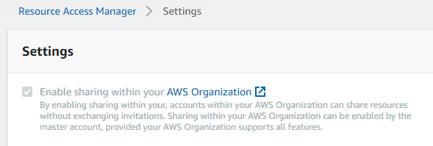
AWS RAM setting (in MBA)
Enable sharing at the top-most level within your organization
This setting affects all services, and not just Route 53 Resolver, so ensure that this setting complies with your security policy

Slide 42
Route53 Resolver best practices
By maintaining your Route53 Resolver rules in a single, centralized account, multiple rules can all use the same inbound/outbound endpoints
Determine where you will forward internet-resolvable names—to internet (via AWS) or on-prem?
Make use of RAM to ensure you’re not duplicating rules and endpoints in multiple accounts.
Remember that use of shared Outbound endpoints does NOT require peering or TGW!
For services that require “individualized VPC” resolution, create an Inbound endpoint in the VPC and access from shared VPC.

Slide 43
Demo
Use-Case 1
Use-Case 2
Use-Case 3
Use-Case 4
Use-Case 5
Use-Case 6 (Before)
Use-Case 6 (After)

Slide 44
Code Repo
Associate PHZ with VPCs

Slide 45
Questions?

Slide 46
Learn security with AWS Training and Certification
Resources created by the experts at AWS to help you build and validate cloud security skills
30+ free digital courses cover topics related to cloud security, including Introduction to Amazon GuardDuty and Deep Dive on Container Security
Classroom offerings, like AWS Security Engineering on AWS, feature AWS expert instructors and hands-on activities
Validate expertise with the AWS Certified Security - Specialty exam
Visit aws.amazon.com/training/paths-specialty/
Notes:
Security, Compliance, and Identity Track – Amy Walker Barrs
Speaker Notes:
You came to re:Invent to learn. There’s no need to stop when you go home.
Keep re:Inventing with resources from AWS Training and Certification for security which is important for everyone, no matter what your role.
According to Global Knowledge, for the fourth year in a row, IT decision-makers report having the most difficult time finding qualified cybersecurity talent so training has never been more important.
We offer 30+ courses for you and your teams around security, identity, and compliance, including free digital courses and in-depth classroom offerings, including AWS Security Engineering.
The comprehensive AWS Certification validates your team’s technical expertise in securing the AWS platform.
For more information, visit aws.amazon.com/training and look for the security learning path.

Slide 47
Paul Bayer
paulbaye@amazon.com

Slide 49
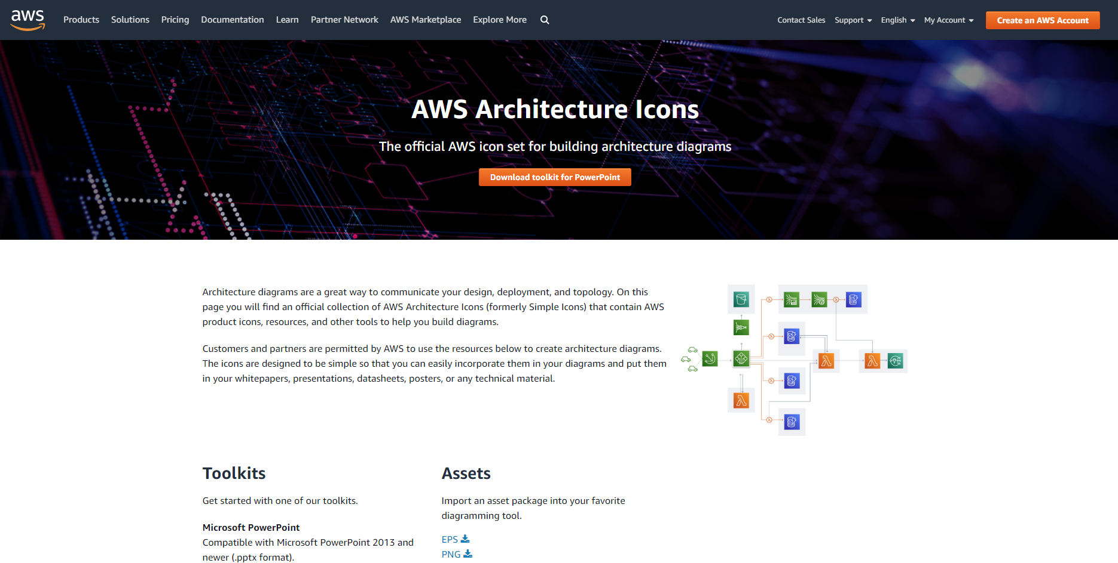
AWS product and resource icons
Download icons to use in your presentation here: https://aws.amazon.com/ architecture/icons/

Slide 50
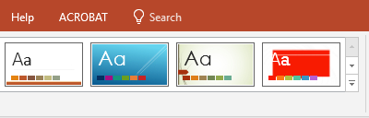
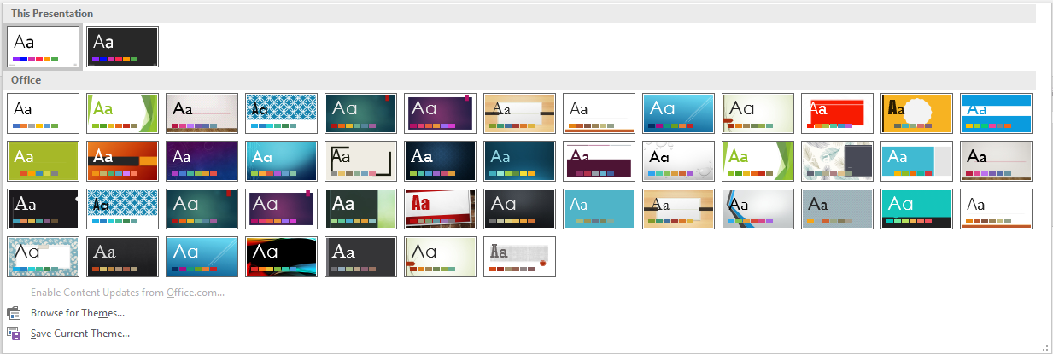
How to apply the template
Apply the template to an existing PowerPoint presentation
Save this template to your desktop.
Open an existing PowerPoint file that you want to update.
Select the Design tab, select the down arrow, scroll down, and select Browse for Themes.
Browse to the template file (.potx) you saved to your desktop, and select Open.
Now, you need to apply the template layout to each slide. On each slide, right-click the slide thumbnail, and under Layout, select the template layout you want to apply to the slide.
Adjust accordingly to get the slide the way you want it.

Slide 51
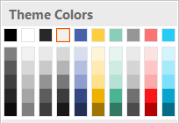
Theme colors
The PowerPoint palette for this template has been built for you and is shown below.
Limit color usage to two of the six accent colors shown. Do not use different shades of a color.
Text and slide background colors
R: 0
G: 0 B: 0
R: 255
G: 255 B: 255
R: 0
G: 43 B: 71
R: 240
G: 240
B: 240
Accent colors
R: 72
G: 97
B: 173
R: 255 G: 206 B: 63
R: 136 G: 206
B: 184
R: 150
G: 150
B: 150
R: 253
G: 114
B: 114
R: 37
G: 204
B: 247

Slide 52
Five-icon layout example
Label
Description of the concept.
Label
Description of the concept.
Label
Description of the concept.
Label
Description of the concept.
Label
Description of the concept.

